Slide 1
Data base
Close the data table then click on external data at the top of screen. Then click Text File. And new windows will come up. Click browse then find the file you want to import.
Drop down list
Change the data type to look up wizard on design view.
Then in the new windows that come up click “I will type in the values that I want”
Meat Plants Seeds Fish Fruit

Slide 2
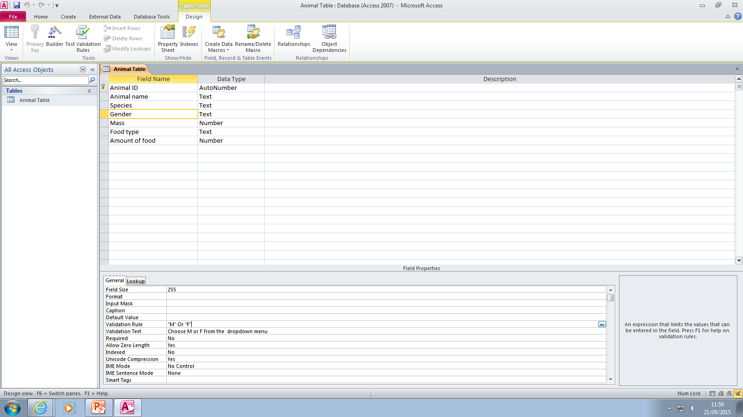
Validation rule

Slide 3
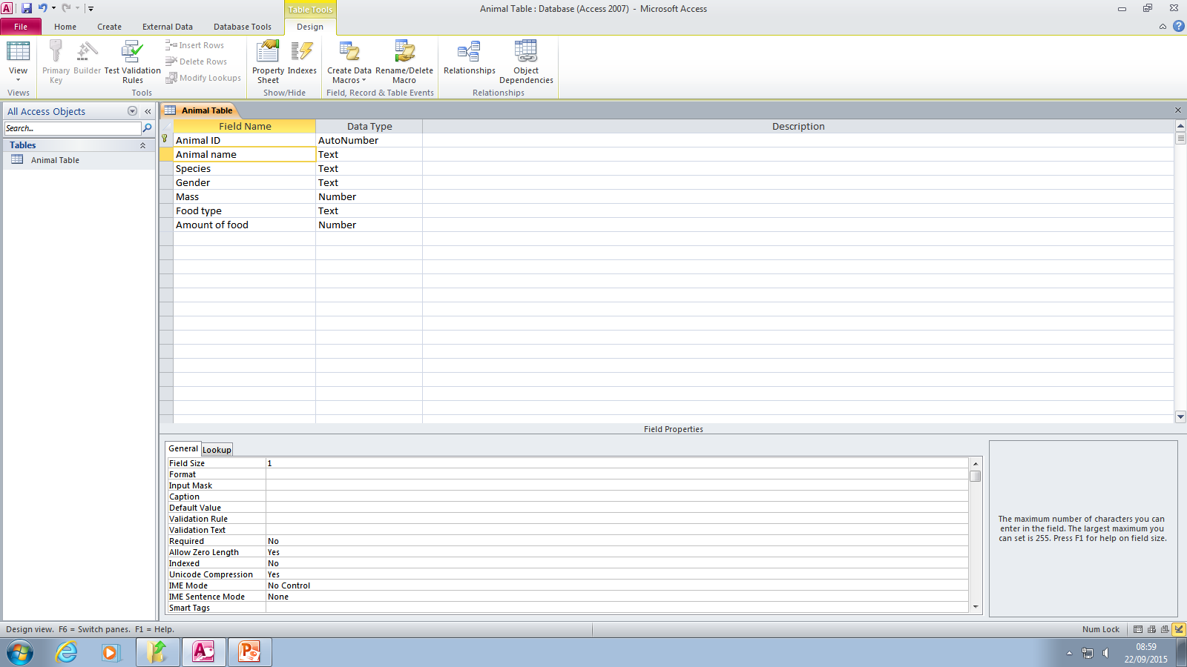
Change field size to the smallest value you need
Form: close the file your working on go to create then click form wizard select the table. And fields

Slide 4
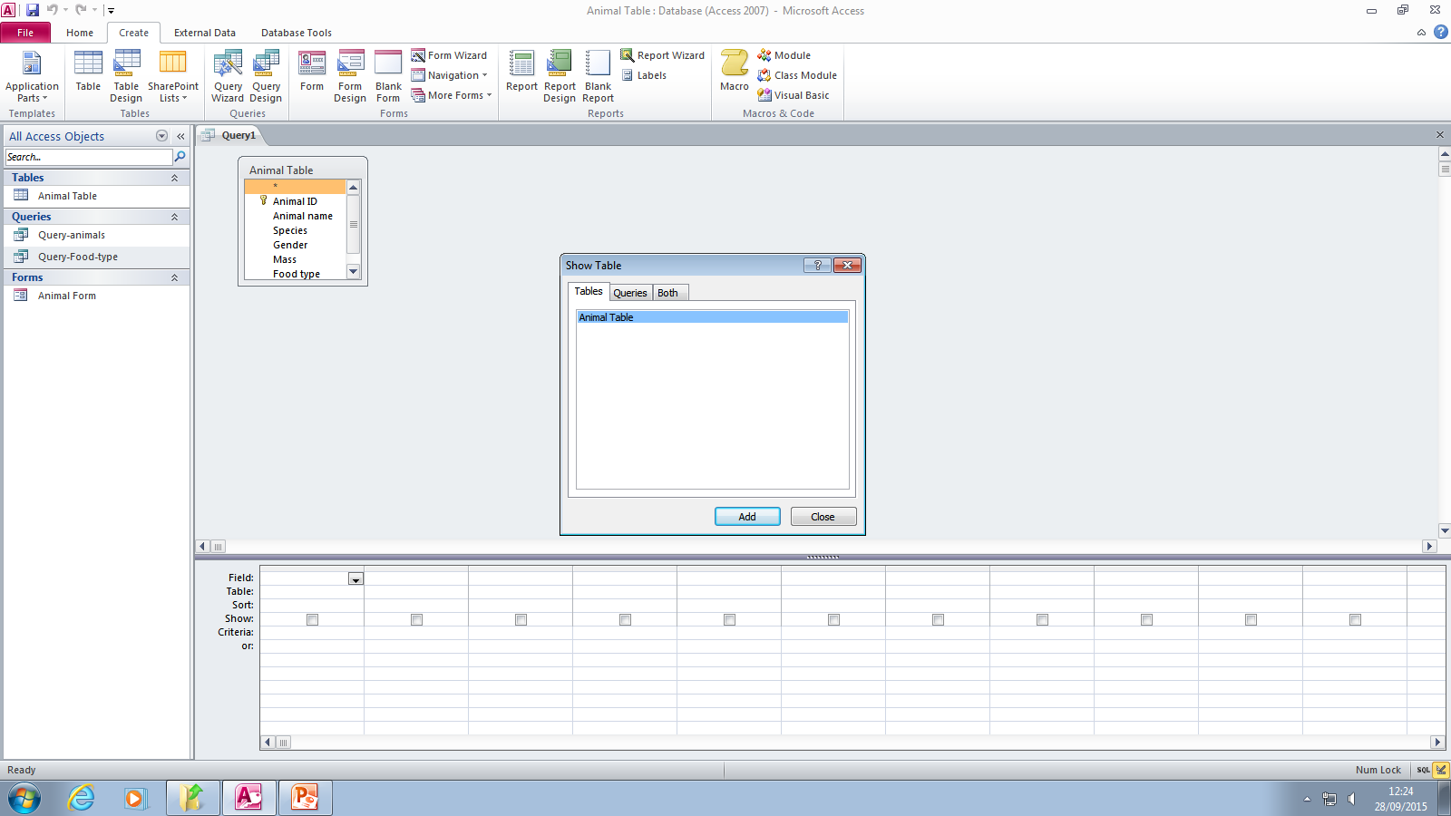
Too Create a query. Close other data sheets then click on create at top of screen, then click query design. Choose a table to add then click add. Then click close.

Slide 5
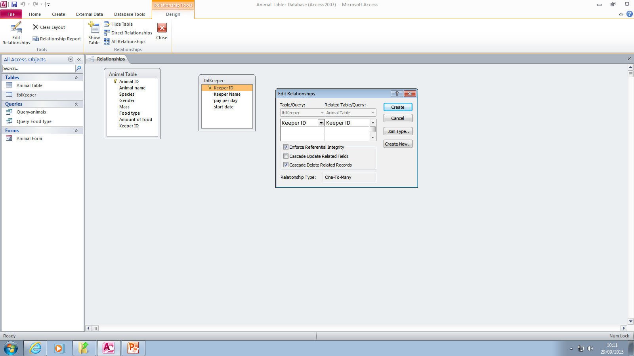
Linking tables (relationship) click data base tools then click relationships add the tables you want to connect. Then drag the keeper ID to the other keeper ID. Click create. Then close the Relationship.

Slide 6
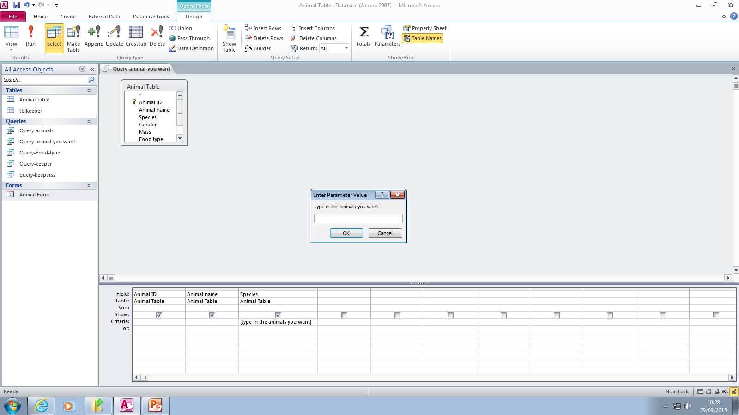
Parameter query create a query add in the table then in criteria in square brackets type on the text e.g.[type in all the animals you want]

Slide 7
Click create tab, click report wizard, choose the available fields you want, click next, click next again, choose a sort order, click next, click finish.

